Slide 1
2
MC : a cryptocurrency portfolio solution
Marcus Chen
Siobhan Harrington
Ted Pham
Sylvia Yang

Slide 2
MC² Mission
Problem
The $200 B cryptocurrency market is a high growth opportunity for investors, but its volatility prevents many institutional investors from taking advantage of this asset.
Mission
Build a cryptocurrency portfolio that is controlled for volatility and provides consistent return
Notes:
Slyvia

Slide 3
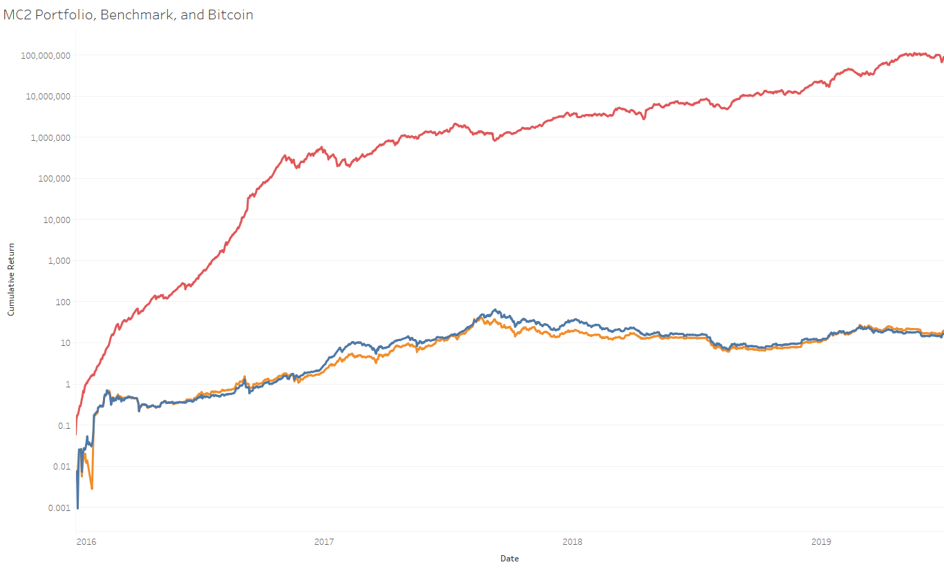


Mission Accomplished - Consistent Return
MC2 Portfolio, Benchmark, and Bitcoin
2
MC
Long/Short Strategy with limited market exposure enabled great returns while smoothing out the market dips (market drawdown)
MC² Optimized Portfolio
500 Coin Benchmark (like S&P)
Bitcoin Only
Notes:
Sylvia
This slide illustrates our goal.
The blue line indicates the cumulative return of just bitcoin. So this is a simple strategy
The red line indicates a portfolio that was diversified very simply- it’s just a weighted average of 500 currencies. This is similar to the S&P in the stock market It is still fairly volatile.
Our goal is to create a portfolio that reflects the orange line. It will be an optimized portfolio that ensures a consistent return.
In the coming slides, we’ll explain our approach and how we will evaluate our methods.
Our goal is building the green return

Slide 4
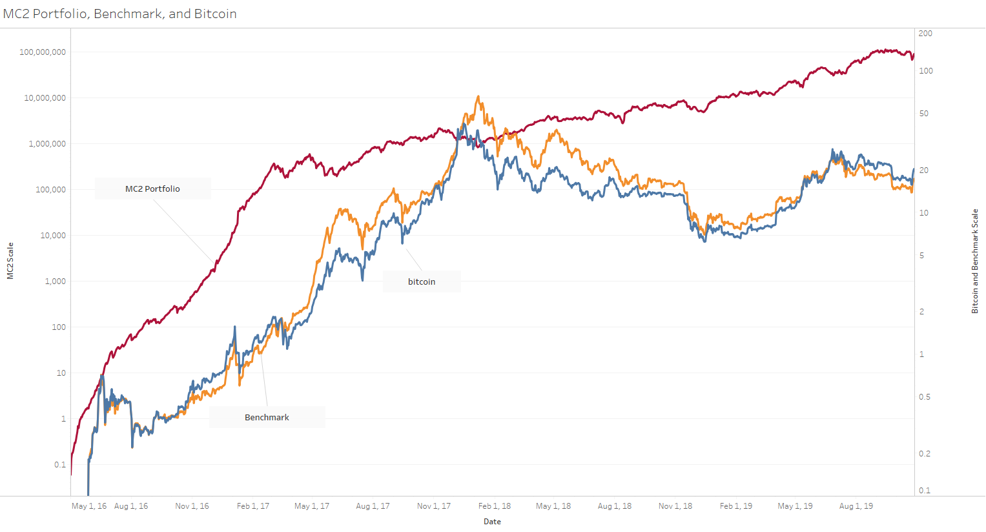
Mission Accomplished - Reduced Volatility
MC² Optimized Portfolio
500 Coin Benchmark (like S&P)
Bitcoin Only
Notes:
Slyvia
This slide illustrates our goal.
The blue line indicates the cumulative return of just bitcoin. So this is a simple strategy
The orange line indicates a portfolio that was diversified very simply- it’s just a weighted average of 500 currencies. This is similar to the S&P in the stock market It is still fairly volatile.
Our goal is to create a portfolio that reflects the green line. It will be an optimized portfolio that ensures a consistent return.
In the coming slides, we’ll explain our approach and how we will evaluate our methods.
Our goal is building the green return
Our goal is building the green return

Slide 5
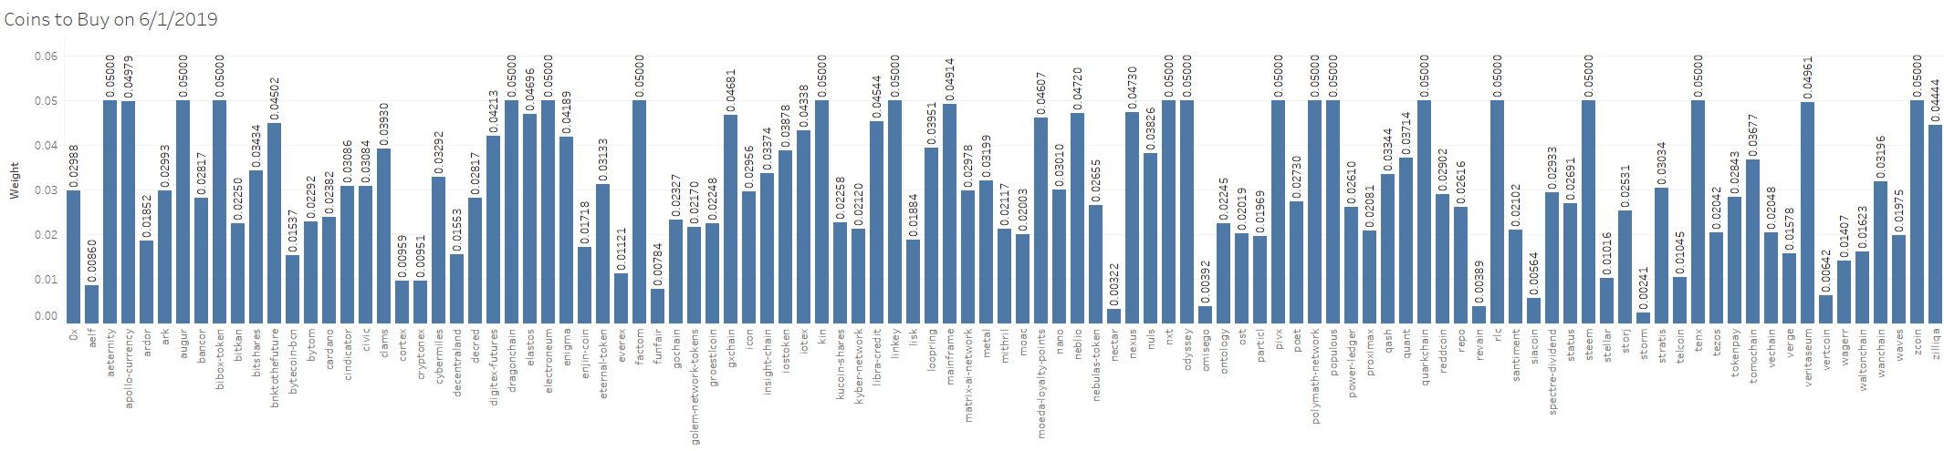
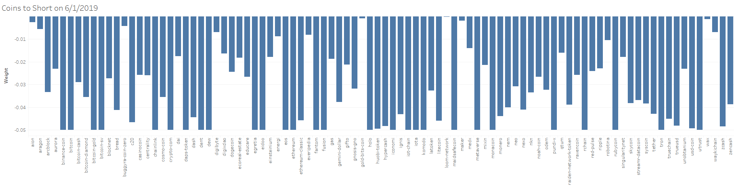
How We Did It - Snapshot of June 1, 2019
Notes:
Sylvia
This slide is a snapshot of our portfolio on June 1. The top section reflects all the buy/holds our portfolio recommends along with the recommended weights. The bottom section represents all the shorts where the portfolio recommends to borrow shares and immediately sell them expecting the price to decrease and repurchase the shares at a later point in time for profit.
Our optimizer runs daily to indicate the best mix of coins. Our portfolio changes drastically over time as market conditions change.
We used traditional finance methods like the “Efficient Frontier” method to find the sweep spot between return and volatilty. This concept has been the cornerstone of Modern Portfolio Theory since the 1950’s.

Slide 6
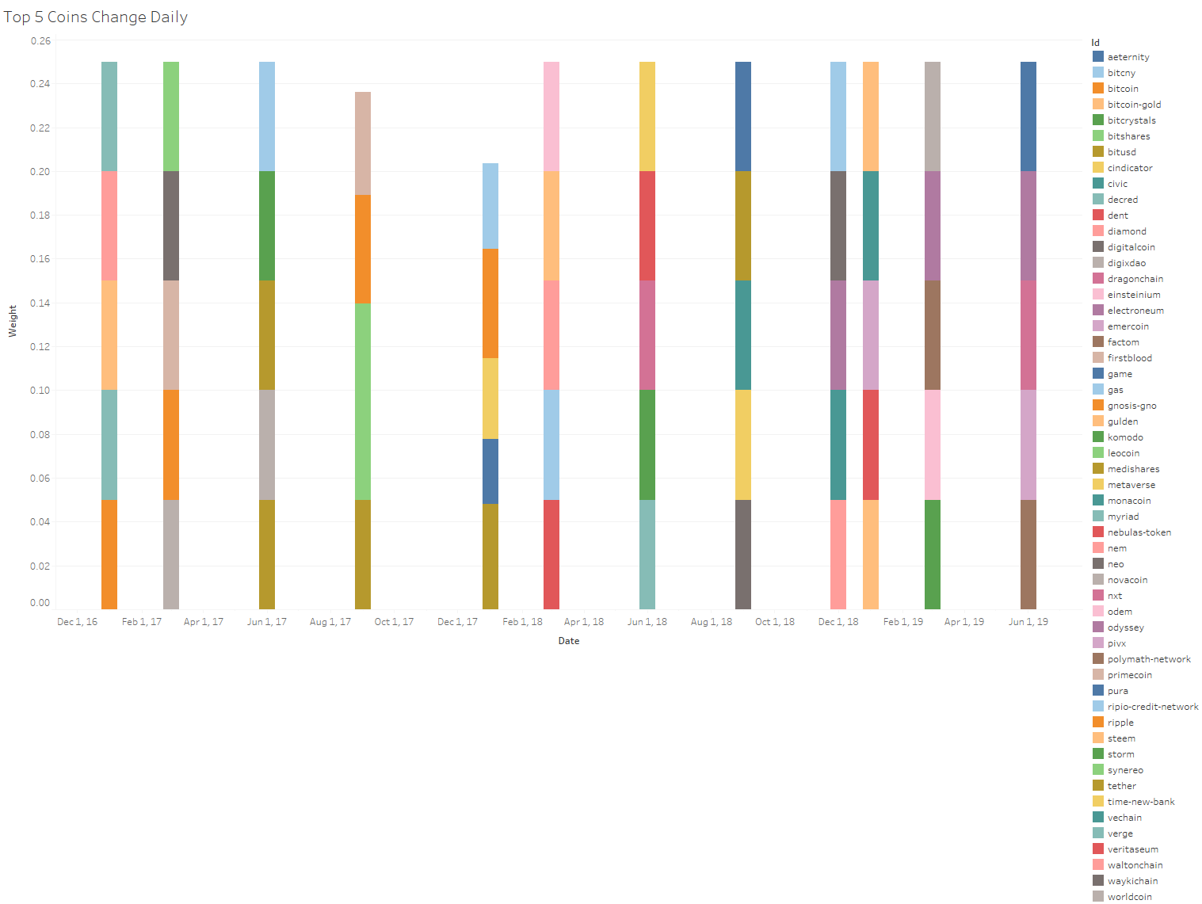
How We Did It
Notes:
Sylvia

Slide 7



High Level Approach
Step 1: Feature Engineering
& Selection
Feature Extraction
Characteristic Portfolio
Information Ratio
Selected?
Momentum
Momentum
Momentum
AWS
DB
Lead/Lag
Lead/Lag
Lead/Lag
Reversal
Reversal
Reversal
LSTM
LSTM
LSTM
Constraint
Strategy
Step 2: Portfolio Construction
Daily
Optimizer
Weighted Portfolio
of 100 coins
Reversal
500
Notes:
Ted
Our approach consist of two major components:feature engineer, selection and portfolio construction
Here we give you a high level overview of each step and will go into further details in later slide.
The first step, we engineer feature from the raw data we obtain daily from coinmarketcap
We use characteristic portfolio and the derived information ratio to select the best feature in this case Revesal
On the 2nd step we construct the portfolio with a daily optimizer given constraint strategy to obtain the weighs for the top 500 coins

Slide 8
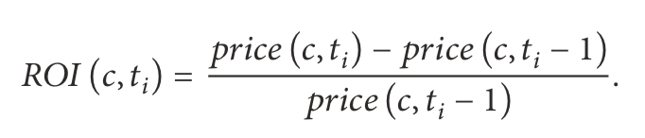
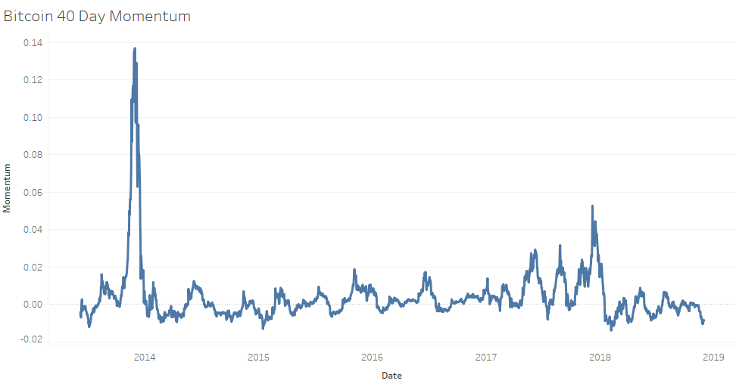
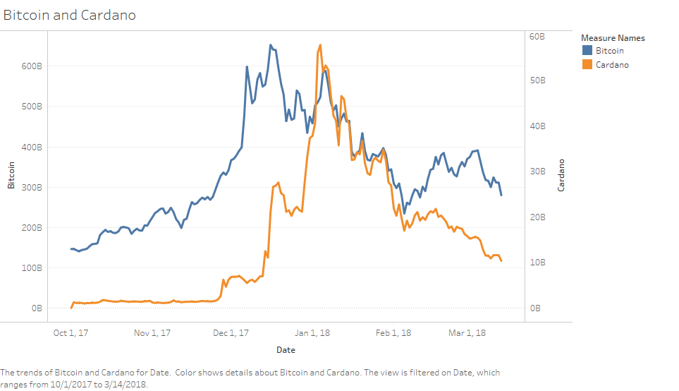
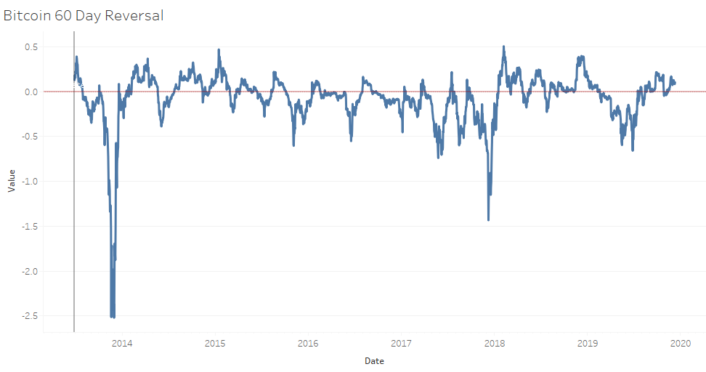
Feature Engineering
 | Momentum | Lead Signal | Reversal Signal | Predicted ROI
Intuition | Measure Trend Strength of Trend Bullish vs Bearish | “Star” currencies move first, other follow (right chart) | Detect a reversal of uptrend or downtrend | Daily predicted ROI from previous 50 days (LSTM)
Computation | Price_{T} - Price_{T-N_days} | mean, weighted-avg | Price_{T} - avg(Prices) | LSTM
Tunable Parameters | # of day N 10,20,30,40 | # days, # top currencies | # days best 60 day | Coin’s Features, Epochs, dropout
Bitcoin leads Cardano
Zero momentum
Notes:
TED
Positive reversal means we buy
Downtred reversal
Negative

Slide 9
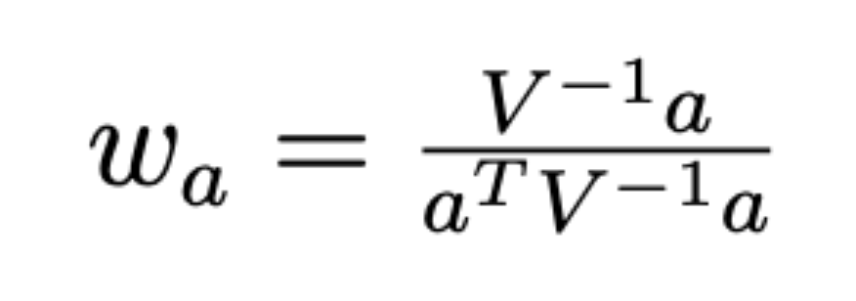
Feature Selection starts with Characteristic Portfolio
For a feature a, we can construct a Characteristic Portfolio that has
minimum risk and a unit exposure to feature a. The Characteristic Portfolio will help
us compute the information ratio (IR) for feature selection
For a feature a
a= {a_{C1}, a_{C2},...,a_{C500}}
V = Covariance Matrix
1
2
Average (returns)
STDEV (Returns)
C₁
C₂
C₅₀₀
w_{a} = {w_{C1}, w_{C2},...,w_{C500}}
* * *
C₁
Solve for characteristic portfolio weight
𝛔²₁
𝛔²_{1,2}
𝛔²_{1,500}
* * *
C₂
𝛔²₂₁
𝛔²₁
𝛔²_{2,500}
* * *
*
* * *
*
Analytical Solution
Secret sauce
C₅₀₀
1
𝛔²_{500,1}
𝛔²_{500,2}
𝛔²₅₀₀
2
IR (Daily returns computed)
See appendix for detailed formulas
Notes:
Ted
Doesn’t have any constraint
Market exposure
Leverage
Market neutral
Build strategy
e.g. covariance of 0.22 means benchmark increase by 1 0%, coin increases by 2.2%
Marcus
The Characteristic portfolio is a portfolio that has unit exposure to the target feature and minimized risk. It tries to analyze the impact of the feature while controlling the impact from other variables.
We used the CAPM (capital asset pricing) model to measure the market risk. The CAPM model breaks down the volatility of each coin into market and coin specific risk.
Seperate the volatility (or variance) of the individual coin from the market.
Calculate the specific return associated with the coin, not the market
Calculate the specific risk associated with the individual coin, not the market
Estimate the porfolio weights based on the risk model covariance matrix and our feature
Risk model uses capm model. <insert a blurb - this is standard financial model that incorporates specific risk, etc)
Combining the covariance based on our risk model between coin and benchmark with the individual feature, we calculate the best weights to minimize volatility based on the feature
V = beta (#1) * covariance matrix * transposed beta + specific risk (#3)
a = feature

Slide 10
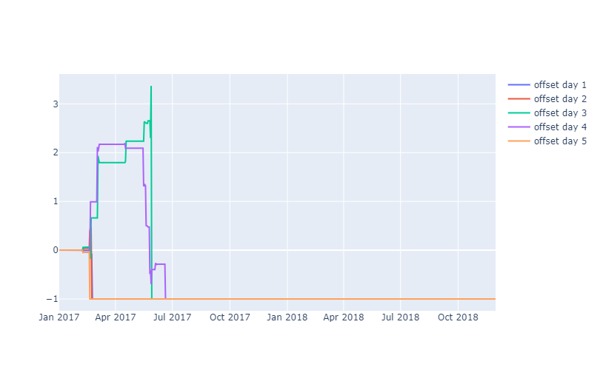
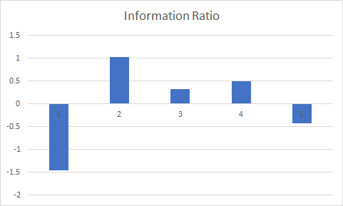
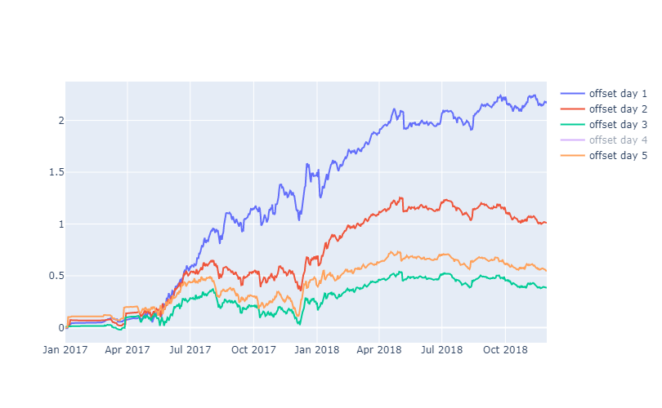
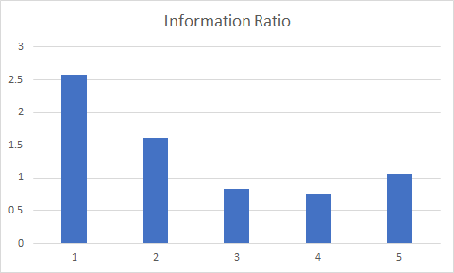
Feature Selection Using Characteristic Portfolio Results
20 Day Momentum
Cumulative Return
Δ(Days)
60 Day Reversal
Average (returns)
STDEV (Returns)
IR =
Δ (Days)
Notes:
Ted
The data used for these graphs was created by the characteristic portfolio

Slide 11
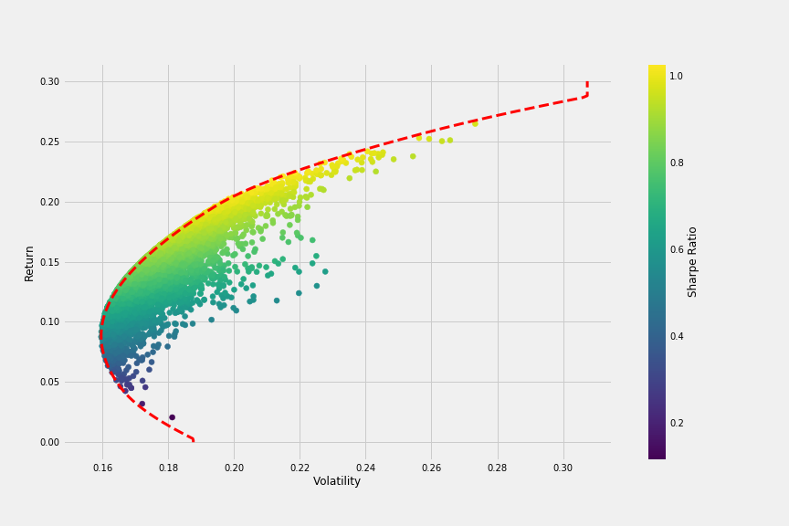

Portfolio Construction
Modern Portfolio Theory (MPT)
There is a trade-off between risk and return
Risk is measured as the standard deviation of return
Efficient Frontier
Capital Asset Pricing Model (CAPM)
Systematic risk and specific risk
Idiosyncratic risk can be reduced through diversification
Beta (coefficient) measures the exposure to the market movement
Source: https://towardsdatascience.com/python-markowitz-optimization-b5e1623060f5
Notes:
Marcus
Before we dig into the portfolio construction, I’d like to share two profound research that laid the foundation for the asset management industry.
In 1952 Harry Morkowitz introduced the modern portfolio theory, which won him a Nobel prize later. The theory identifies the trade off between a portfolio’s risk and return, where risk is proxied by the standard deviation of the return. In theory there exists an efficient frontier, the portfolios on the frontier has the highest return given a certain level of risk. On the right hand side there is an efficient frontier simulated using Monte-Carlo simulation.
Another Nobel winning model -- Capital Asset pricing Model was introduced in the 1960s by William Sharpe and others. The model decomposes security return from different sources, including risk free rate, market return and residual return. Using this framework the risk can be decomposed into Systematic risk and specific risk. specific risk is also called idiosyncratic risk or residual risk. Because the specific risk is uncorrelated across assets in theory, it can be reduced to almost 0 through diversification. The coefficient beta in this model measures a security’s the exposure to the market movement.
The characteristic portfolio is efficient, however it is unconstrained, meaning it does not consider leverage, trading cost or risk exposure. In real life we need to use optimization that considers bounds and constraints.
The portfolio construction is in essence a Lagrange Optimization problem. It aims to maximize the utility function, which is defined as alpha minus lambda * predicted variance. Lambda is the Lagrange multiplier, it indicates how much we want to penalize the risk. It is also known as risk aversion score in economics, because the higher the lambda is, the lower We are running a long short portfolio so the weight will sum up to 0. We applied -5% to 5% bounds to each individual currency. On the alpha side we used the 20day reversal and LSTM signal. The optimizer will give us the optimized portfolio weight for the next trading day. We then calculate the the cumulative return for the whole time and sharpe ratio, information ratio and maximum drawdown. Based on the result we will go back and update the parameters and bounds and run the next iteration, until we get satisfied results.

Slide 12
Portfolio Construction
Lagrange Optimization
Utility function (maximize):
alpha - λ * Var
λ: how much we want to penalize the risk
Constraints:
Fully invested / money neutral
Tracking market / limit market exposure
Bounds:
Maximum exposure to a single currency
Input:
Aggregated alphas (normalized)
Risk exposure and covariance matrix
Output:
Weights for each asset
Combined
Alpha
Score
Risk
Exposure
Optimizer
Weight
Notes:
Marcus
The portfolio construction in practice is essentially a Lagrange Optimization problem. It aims to maximize the utility function, which is defined as alpha minus lambda * predicted variance. Lambda is the Lagrange multiplier, it indicates how much we want to penalize the risk. In economics lambda can be seen as measurement for risk aversion.
Constraints:
We can define whether a portfolio is fully invested or stay money neutral, and whether track the market movement.
Bounds:
Limit exposure to any single currency. In stocks we can also use the bounds to limit exposure in industries.
Input:
Aggregated alphas (normalized)
Risk exposure and covariance matrix
Output:
Weights for each asset. The weights will be used to construct the portfolio for the next trading day.

Slide 13
Portfolio Construction
Optimizer
Sequential Least SQuares Programming Algorithm (SLSQP)
Gradient Based
NonLinear Constraints
Widely used among quantitative funds
Scipy implementation
https://en.wikipedia.org/wiki/Sequential_quadratic_programming
Combined
Alpha
Score
Risk
Exposure
Optimizer
Weight
Notes:
Marcus
The optimization algorithm we used is called Sequential Least SQuares Programming Algorithm (SLSQP). The search is gradient based, it accepts Nonlinear constraints, and is widely used among the quants. We used the Scipy implementation.

Slide 14
Backtesting
Proposed Strategies
Long-Short
Constraints:
sum(w_{i}) = 0
sum(w_{i} * beta_{i}) = b
Bounds:
-0.05 <= w <= 0.05
Params:
λ, b ~ (0, 0.3)
Long-Only Active
Constraints:
sum(w_{i}) = 1
sum(w_{i} * beta_{i}) = b
Bounds:
0 <= w <= 0.05
Params:
λ, b ~ (0.5, 1)
Parameter tuning
Dev data
2016 - 2018
Test data
2019
Performance measurement
Return
Sharpe ratio
Notes:
Marcus
We ran two set of strategies. The first one is a long short strategy. It can fund the money needed for buy with proceeds from the short sell. This kind of strategy can take the most advantage of alpha predictions, however it can easily generate large amount of loss if the alpha is not working. The bounds is set to limit any currency from taking more than 5% of the gross weight. We also experimented with the amount of market exposure to take.
The second strategy is a long only one. We designed it to be fully invested without using leverage. The bounds for any single currency is 0 to 5%. This kind of strategy can help us generate return from bullish market and also give us some tailwind on the alpha bets.
For both strategies we leave the lambda (risk aversion) and target beta as the parameters to tune. Then we run backtest on 2016 - 2018’s market data using the cumulative return and sharpe ratio as the performance measurement. We held out the 2019 data as our test data.
We have tried a series of parameters and selected the best combination based on the results observed between 2016 and 2018. Then we continue to generate results for 2019 using the selected parameters.

Slide 15
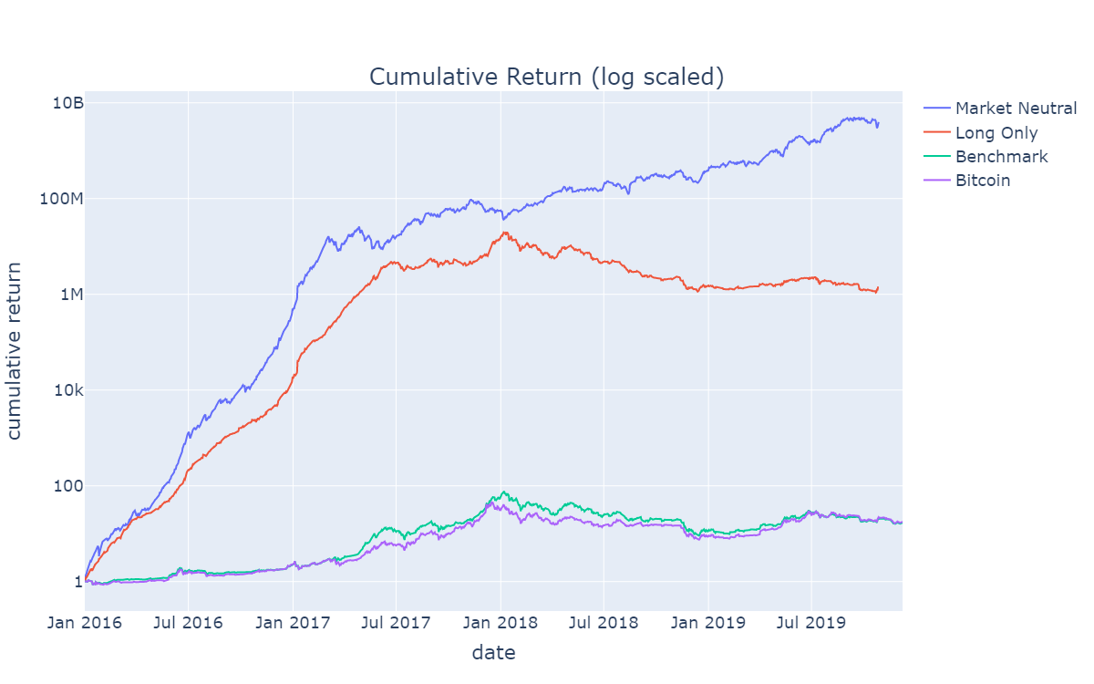
Results
Sharpe Ratio
 | 1 year | 2 year | 3 year | Since 2016
market neutral | 3.17 | 2.59 | 3.98 | 5.30
long only | -0.29 | -0.27 | 2.66 | 4.38
benchmark | 1.10 | -0.06 | 1.33 | 1.33
bitcoin | 1.48 | -0.16 | 1.33 | 1.34
Notes:
Marcus:
The market neutral strategy generated consistent return. Even though the profitability has decreased since 2017, it remains positive in regardless of the market situation.
The long only active strategy performed well prior to July 2017. It suffers greatly from the no-short constraint and the market risk exposure when the market turned bearish.

Slide 16

Achievements and Learnings
Generalized traditional financial market theory to cryptocurrency and layered in machine learning techniques
Key Learnings
Cryptocurrency Market
Financial Engineering Techniques
Python Optimizer
Key Challenges
Market History is limited
Volatile Data
100M in revenue gains since May, 2016 and low draw back
Notes:
Siobhan
Thanks, Marcus
In our approach, we chose to use proven financial engineering that has worked in traditional finance for decades - in part because our team had this specific expertise. There are a lot of websites dedicated to crypto portfolio optimization using a variety of methods. However, we never found one that uses characteristic portfolios the way we did.
Key Learnings - we had several key learnings.
We all learned a lot about the crypto currency industry. In terms of pricing data, the crypto industry aligns well with traditional finance. However, the lack of fundamentals means that we have some limits. Signal that typically work well in traditional finance failed us. We would have liked to use multiple features in our optimizer, but we were grateful to find our reversal feature.
Financial Engineering Techniques - there is a lot you can do with price over time. We relied on Grinold’s financial engineering textbook and learned new ways to look at the signals. We also learned about LSTM - which is starting to show a lot of promise in the hedge fund industry.
Finally, the python optimizer and SLSQP was new to us. It gave us a lot of flexibility to try a number of strategies.
Key Challenges - Industry is young and still evolving - many coins come and go and we have not seen how crypto reacts to all market conditions - especially overall economy downturns. Because the industry is young and many large players are still not fully invested, the market is more volatile than traditional markets.
What Worked - Our PORTFOLIO! We would have made100M dollars using this method over the past 3 years. Even more importantly, we kept our drawback low, so our returns remained much more consistent than the volatile market.

Slide 17

Next Steps and Areas for Improvement
Coin Clustering
Stable Coins
Market Leaders
Interest Bearing Coins
Back Testing in varied market scenarios
Explore New Signals
Tune LSTM signal
Refine the Risk Model to include more factors
Refine the Optimizer
Integrate Transaction Costs
Notes:
Signals - leaders
What could be improved?
1 - Crypto Coins have different purposes - “stable coins” are tied to traditional currencies, “market leaders” are working towards going mainstream by going transparent and looking for regulation. “Interest bearing coins” are looking to entice investors with incentives beyond returns.And yet still others protect the identify of the purchaser. With more time, we could have researched individual coins and clustered them together in our analysis.
2 - Back Testing - incorporate crossover validation and scenario testing. If we had another 2 weeks, this is where we would focus to ensure
3 - LSTM took 2 weeks to run so we did not have the chance to tune parameters fully. The industry is showing a lot of promise with sophisiticated LSTM application. Time series models are rare in the industry right now because of their stationary requirements. LSTM has the ability to extract non-linear relationship.
4 - Continue to refine the risk model with more factors
5- There are limitless number of strategies, just like modifying the parameters in a machine learning challenge, we could further refine our strategy by tweaking the constraints to come up with the best results
6 - Incorporate transaction cost
Next Steps - continue to develop and refine signals. LSTM is having good results in the real world when differentiated by industry, we will continue to refine our LSTM model. We will also explore new signals
Tweak the optimizer. The SciPy optimizer is very flexible allowing us to modify the constraints and bounds to find the best results

Slide 18

Testimonials From the Field
“Interesting approach, let’s talk when you integrate transaction costs” - Manager at Hedge Fund
“Textbook approach to the art of signal identification. Beautiful” - Financial Engineering Enthusiast
“I am going to use a similar code structure at my job.” Ted and Marcus
Notes:
Dont just take our word for it….

Slide 19
Wrap Up
We set out to build a cryptocurrency portfolio that balanced volatility and return by applying a systematic investment approach to crypto currency
We leveraged financial engineering including Min Variance Optimization and Characteristic Portfolio in a machine learning like environment. We also experimented with machine learning algorithms like neural net.
Bottom line, our portfolio’s max draw down never dipped significantly despite huge drops in the market over the past 3 years.
Interested? For more information, please check out our website at
http://groups.ischool.berkeley.edu/crypto_portfolio/crypto_portfolio/.
Notes:
Siobhan

Slide 20
Appendix

